Slide 1
Unit-3
K-Nearset Neighbour (KNN)

Slide 2
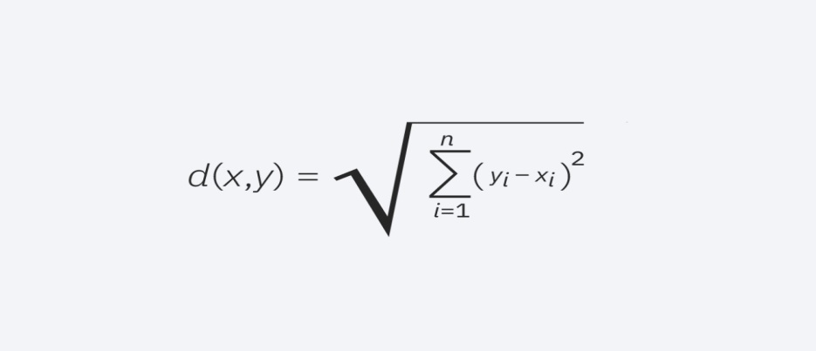
Several distance measures
Euclidean distance (p=2): This is the most commonly used distance measure, and it is limited to real-valued vectors. Using the below formula, it measures a straight line between the query point and the other point being measured.
Euclidean distance formula
Manhattan distance (p=1): This is also another popular distance metric, which measures the absolute value between two points. It is also referred to as taxicab distance or city block distance as it is commonly visualized with a grid, illustrating how one might navigate from one address to another via city streets.

Slide 3
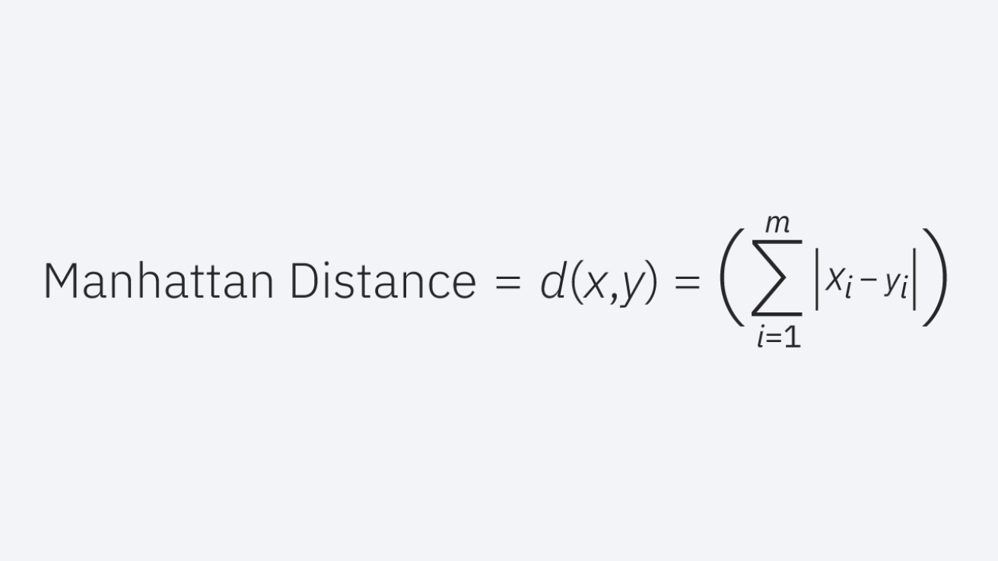

Slide 4
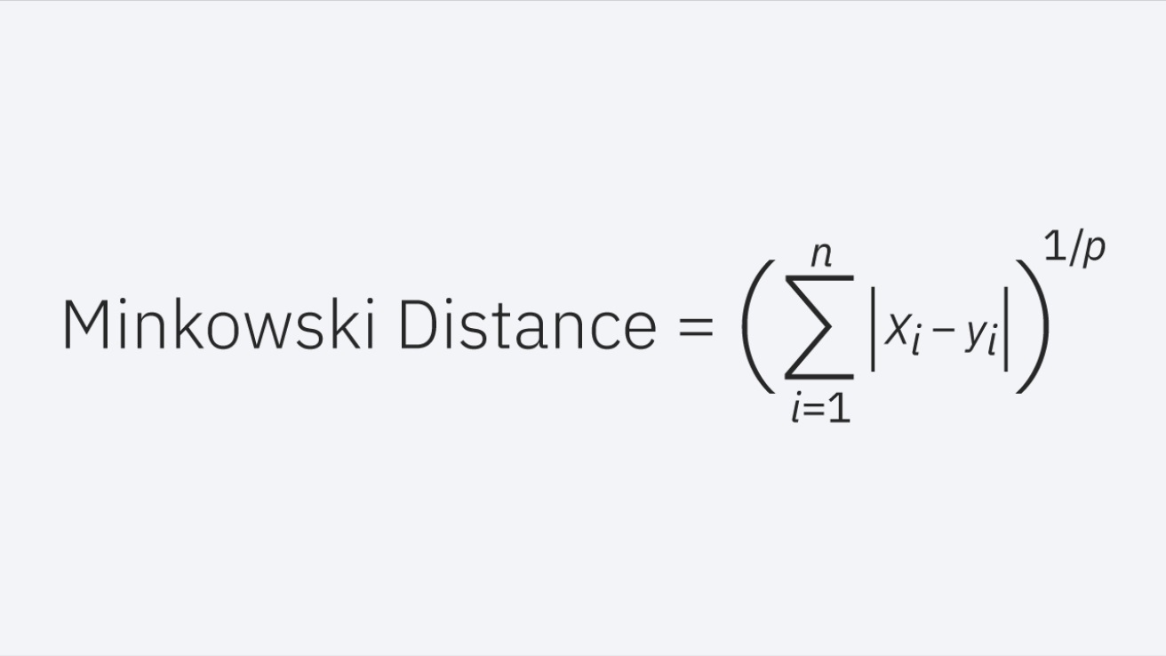
Minkowski distance: This distance measure is the generalized form of Euclidean and Manhattan distance metrics. The parameter, p, in the formula below, allows for the creation of other distance metrics. Euclidean distance is represented by this formula when p is equal to two, and Manhattan distance is denoted with p equal to one.
Minkowski distance formula
Hamming distance: This technique is used typically used with Boolean or string vectors, identifying the points where the vectors do not match. As a result, it has also been referred to as the overlap metric. This can be represented with the following formula:

Slide 5
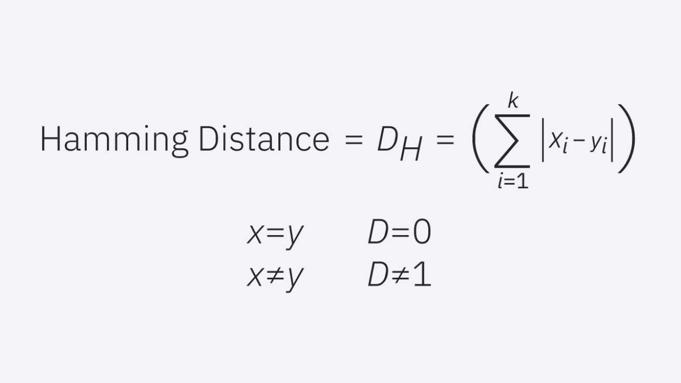

Slide 6
Introduction
K-nearest neighbors (KNN) algorithm is a type of supervised ML algorithm which can be used for both classification as well as regression predictive problems. However, it is mainly used for classification predictive problems in industry. The following two properties would define KNN well −
Lazy learning algorithm − KNN is a lazy learning algorithm because it does not have a specialized training phase and uses all the data for training while classification.
Non-parametric learning algorithm − KNN is also a non-parametric learning algorithm because it doesn’t assume anything about the underlying data.

Slide 7
Working of KNN Algorithm
K-nearest neighbors (KNN) algorithm uses ‘feature similarity’ to predict the values of new datapoints which further means that the new data point will be assigned a value based on how closely it matches the points in the training set. We can understand its working with the help of following steps −
Step 1 − For implementing any algorithm, we need dataset. So during the first step of KNN, we must load the training as well as test data.
Step 2 − Next, we need to choose the value of K i.e. the nearest data points. K can be any integer.

Slide 8
Step 3 − For each point in the test data do the following −
3.1 − Calculate the distance between test data and each row of training data with the help of any of the method namely: Euclidean, Manhattan or Hamming distance. The most commonly used method to calculate distance is Euclidean.
3.2 − Now, based on the distance value, sort them in ascending order.
3.3 − Next, it will choose the top K rows from the sorted array.
3.4 − Now, it will assign a class to the test point based on most frequent class of these rows.
Step 4 − End

Slide 9
Example
Why do we need a K-NN Algorithm?
Suppose there are two categories, i.e., Category A and Category B, and we have a new data point x1, so this data point will lie in which of these categories. To solve this type of problem, we need a K-NN algorithm. With the help of K-NN, we can easily identify the category or class of a particular dataset. Consider the below diagram:

Slide 10
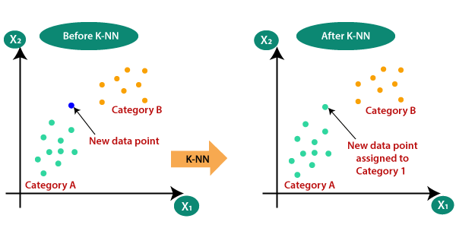

Slide 11
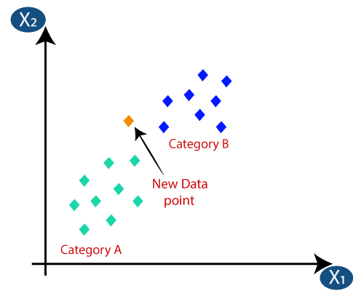
Suppose we have a new data point and we need to put it in the required category. Consider the below image:

Slide 12
Firstly, we will choose the number of neighbors, so we will choose the k=5.
Next, we will calculate the Euclidean distance between the data points. The Euclidean distance is the distance between two points, which we have already studied in geometry.

Slide 13
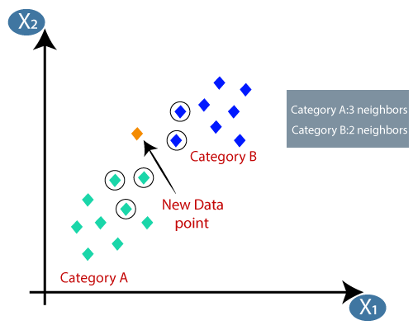
By calculating the Euclidean distance we got the nearest neighbors, as three nearest neighbors in category A and two nearest neighbors in category B
.

Slide 14
As we can see the 3 nearest neighbors are from category A, hence this new data point must belong to category A.

Slide 15
The k-nearest neighbors algorithm, also known as KNN or k-NN, is a non-parametric, supervised learning classifier, which uses proximity to make classifications or predictions about the grouping of an individual data point.
While it can be used for either regression or classification problems, it is typically used as a classification algorithm, working off the assumption that similar points can be found near one another.

Slide 16
For classification problems, a class label is assigned on the basis of a majority vote—i.e. the label that is most frequently represented around a given data point is used. While this is technically considered “plurality voting”, the term, “majority vote” is more commonly used in literature. The distinction between these terminologies is that “majority voting” technically requires a majority of greater than 50%, which primarily works when there are only two categories. When you have multiple classes—e.g. four categories, you don’t necessarily need 50% of the vote to make a conclusion about a

Slide 17
Regression problems use a similar concept as classification problem, but in this case, the average the k nearest neighbors is taken to make a prediction about a classification.
The main distinction here is that classification is used for discrete values, whereas regression is used with continuous ones.
However, before a classification can be made, the distance must be defined. Euclidean distance is most commonly used, which we’ll delve into more below. It's also worth noting that the KNN algorithm is also part of a family of “lazy learning” models, meaning that it only stores a training dataset versus undergoing a training stage.

Slide 18
However, as a dataset grows, KNN becomes increasingly inefficient, compromising overall model performance. It is commonly used for simple recommendation systems, pattern recognition, data mining, financial market predictions, intrusion detection, and more.

Slide 19
This also means that all the computation occurs when a classification or prediction is being made.
Since it heavily relies on memory to store all its training data, it is also referred to as an instance-based or memory-based learning method.

Slide 20
Applications of k-NN in machine learning
The k-NN algorithm has been utilized within a variety of applications, largely within classification. Some of these use cases include:
- Data preprocessing: Datasets frequently have missing values, but the KNN algorithm can estimate for those values in a process known as missing data imputation.
- Recommendation Engines: Using clickstream data from websites, the KNN algorithm has been used to provide automatic recommendations to users on additional content. shows that the a user is assigned to a particular group, and based on that group’s user behavior, they are given a recommendation. However, given the scaling issues with KNN, this approach may not be optimal for larger datasets.

Slide 21
- Finance: It has also been used in a variety of finance and economic use cases. For example, shows how using KNN on credit data can help banks assess risk of a loan to an organization or individual. It is used to determine the credit-worthiness of a loan applicant. highlights its use in stock market forecasting, currency exchange rates, trading futures, and money laundering analyses.
- Healthcare: KNN has also had application within the healthcare industry, making predictions on the risk of heart attacks and prostate cancer. The algorithm works by calculating the most likely gene expressions.

Slide 22
Advantages
- Easy to implement: Given the algorithm’s simplicity and accuracy, it is one of the first classifiers that a new data scientist will learn.
- Adapts easily: As new training samples are added, the algorithm adjusts to account for any new data since all training data is stored into memory.
- Few hyperparameters: KNN only requires a k value and a distance metric, which is low when compared to other machine learning algorithms.

Slide 23
Disadvantages
- Does not scale well: Since KNN is a lazy algorithm, it takes up more memory and data storage compared to other classifiers. This can be costly from both a time and money perspective. More memory and storage will drive up business expenses and more data can take longer to compute. While different data structures, such as Ball-Tree, have been created to address the computational inefficiencies, a different classifier may be ideal depending on the business problem.
- Curse of dimensionality: The KNN algorithm tends to fall victim to the curse of dimensionality, which means that it doesn’t perform well with high-dimensional data inputs. This is sometimes also referred to as the peaking phenomenon , where after the algorithm attains the optimal number of features, additional features increases the amount of classification errors, especially when the sample size is smaller.
- Prone to overfitting: Due to the “curse of dimensionality”, KNN is also more prone to overfitting. While feature selection and dimensionality reduction techniques are leveraged to prevent this from occurring, the value of k can also impact the model’s behavior. Lower values of k can overfit the data, whereas higher values of k tend to “smooth out” the prediction values since it is averaging the values over a greater area, or neighborhood. However, if the value of k is too high, then it can underfit the data.

